Slide 1
Project Title: Team name: Anti-Covid Team leader name: Abhishek Srivastava College name: Vellore Institute of Technology, Bhopal.
Theme: Education
Problem Statement:
Around the world, billions of students have been impacted by the lockdown provoked by the COVID-19 pandemic and are out of school. Build a platform to help parents find free resources appropriate for their children's needs.

Slide 2
Idea / Approach
Around the world, billions of students have been impacted by the lockdown provoked by the COVID-19 pandemic and are out of school, in order to deal with such a critical situation there should be a platform which help student to learn and grow. Time is precious, it should totally utilized. So our team, “Anti-Covid” has decided to built a Web Application which will provide resources to the learners and, will also keep them aware of the present situation of the pandemic by presenting live statistics of Covid 19.

Slide 3
Technology Stack and Use Cases
List of all the tools and technologies :
HTML5
CSS3
JAVASCRIPT
Postman API
Use cases:
HTML5 - It is the standard markup language for creating Web pages.
CSS3 - It is a language that describes the style of an HTML document.
JAVASCRIPT - It is the programming language of HTML and the Web. It makes the webpages interactive.
Postman API – To fetch the live information.

Slide 4
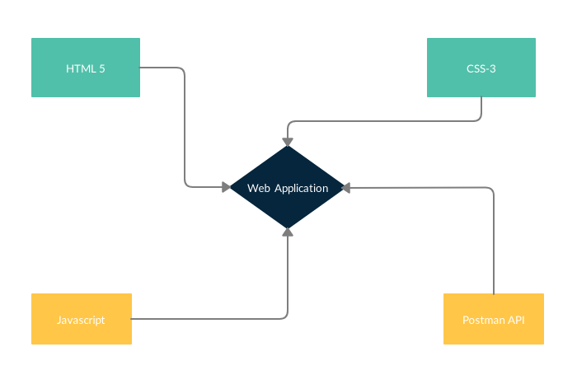
Block Diagram / Architectural Diagram

Slide 5
Dependencies
Web Browser - To render pages.
Internet – To fetch data.

Slide 6
Social Impact Analysis with COVID19
The Web Platform will make a wide social impact. It will provide direction to the ones who are facing numerous issues with respect to education and lack of resources in the pandemic outbreak. The Web Application will help them develop new skills in various domains and maintain a healthy schedule.

Slide 7
Implementation
I have developed the Web Pages using the basic markup language called HTML
Web Pages are designed using Cascade Style Sheets.
Have have made the website interactive implementing Javascript and its various libraries into action.
Further I have made use of Postman API to fetch the live data to be displayed on the web pages.

Slide 8
Link to the project
GitHub link: https://github.com/abhishek2x/HackCovid/
Google Drive link:
https://drive.google.com/open?id=1gnHWnZ4VGQGFxzQlAg3sOD47tJqxe_Ys
Website: https://abhishek2x.github.io/HackCovid/
(Temporarily hosted on Github)

